Slide 1
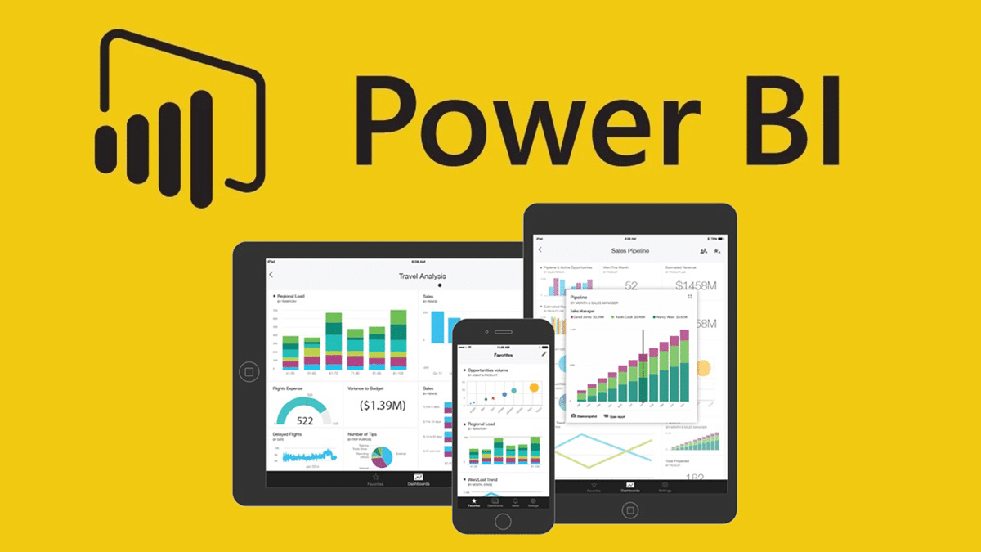


Slide 2
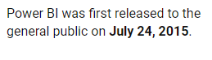
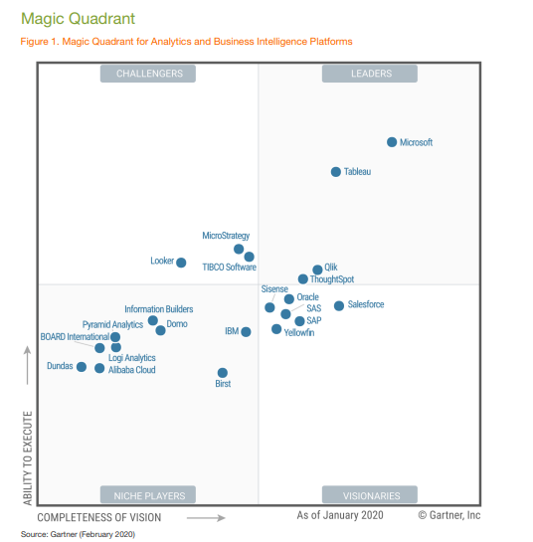
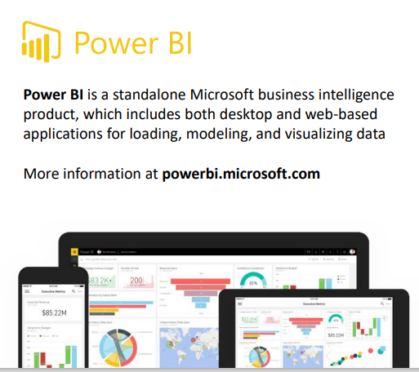
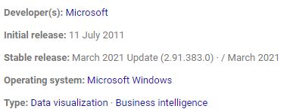

Slide 3

Business Intelligence
Business Intelligence is a set of processes, architectures and technologies or tools that convert raw data into meaningful, presentable report or information.
Business Intelligence combines business analytics, data mining, data visualization, data tools and infrastructure and best practices to help organizations to make data-driven decisions

Slide 4

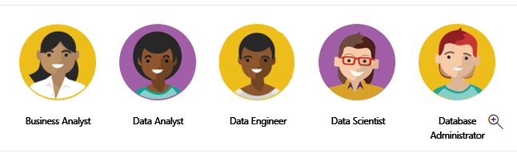
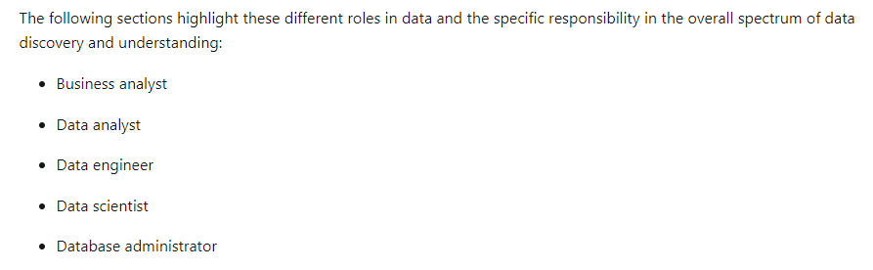

Slide 5
Topics | Description
Introducing Power BI Desktop | Installing Power BI, exploring the Power BI workflow
Connecting & Shaping Data | Connecting to source data, shaping and transforming tables, editing, merging and appending queries, etc.
Creating a Data Model | Building relational models, creating table relationships, understanding cardinality, exploring filter flow, etc.
Adding Calculated Fields with DAX | Understanding DAX syntax, adding calculated columns and measures, writing common formulas and functions, etc.
Visualizing Data with Reports | Inserting charts and visuals, customizing formats, editing interactions, applying filters and bookmarks, etc.

Slide 6
What is Power BI?
Power BI is a collection of software services, apps, and connectors that work together to turn your unrelated sources of data into coherent, visually immersive, and interactive insights. Your data may be an Excel spreadsheet, or a collection of cloud-based and on-premises hybrid data warehouses. Power BI lets you easily connect to your data sources, visualize and discover what's important, and share that with anyone or everyone you want.

Slide 7
The parts of Power BI
Power BI consists of several elements that all work together, starting with these three basics:
A Windows desktop application called Power BI Desktop.
An online SaaS (Software as a Service) service called the Power BI service.
Power BI mobile apps for Windows, iOS, and Android devices.

Slide 8
Power BI Desktop is a freeapplication you install on your local computer that lets you connect to, transform,and visualizeyour data.With Power BI Desktop,you can connect to multiple different sources of data,and combine them (often called modeling) into a data model.This data model lets you build visuals,and collections of visuals you can shareas reports, with other peopleinsideyour organization. Most users who work on business intelligence projects use Power BI Desktop to createreports,and then usethe Power BI serviceto sharetheir reports with others.
What is Power BI Desktop?
The most common uses for Power BI Desktop areas follows: Connect to data Transform and clean that data, to createa data model Createvisuals, such as charts or graphs, that providevisual representations of the data Createreports thatarecollections of visuals, on one or morereport pages Sharereports with others by using the Power BI service

Slide 9
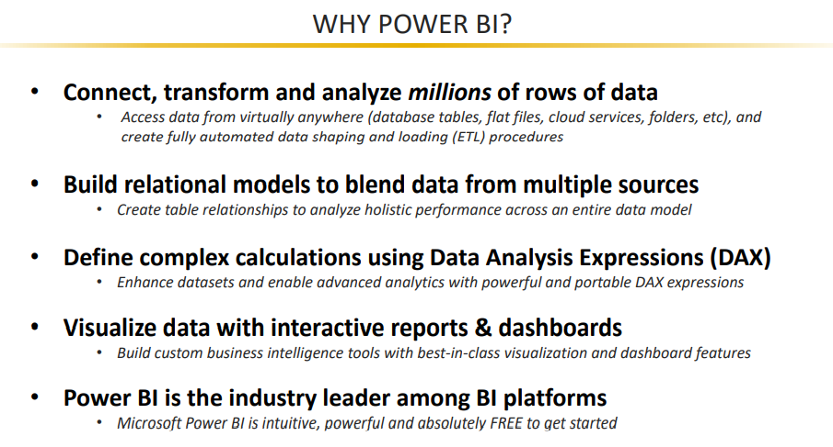

Slide 10
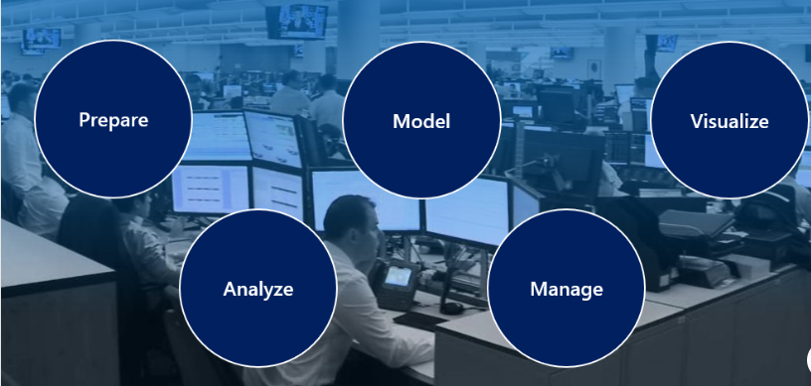

Slide 11
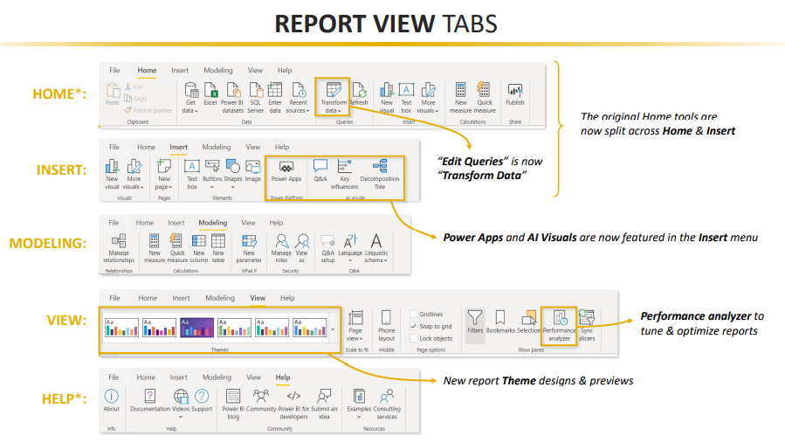

Slide 12
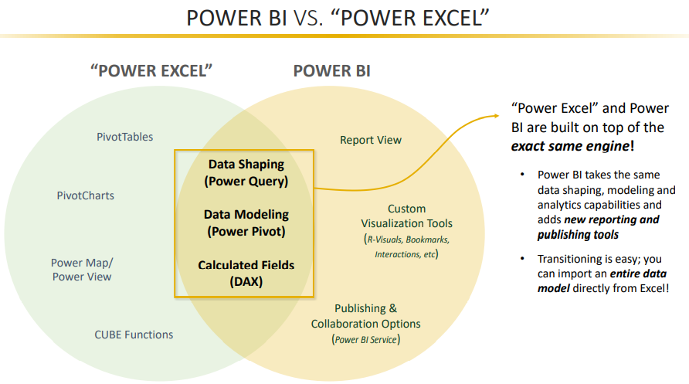

Slide 13
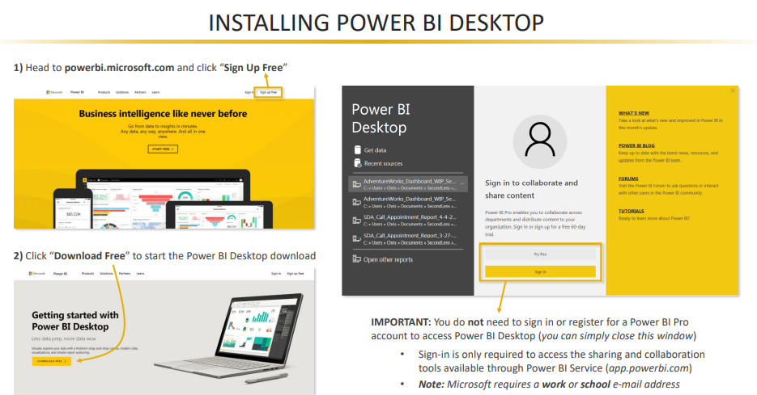

Slide 14
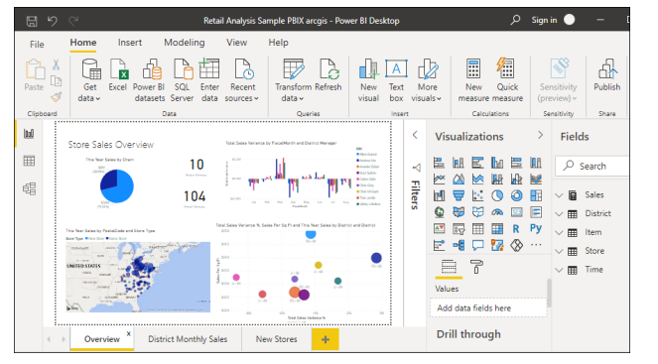
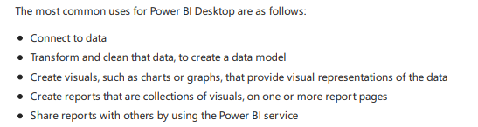

Slide 15
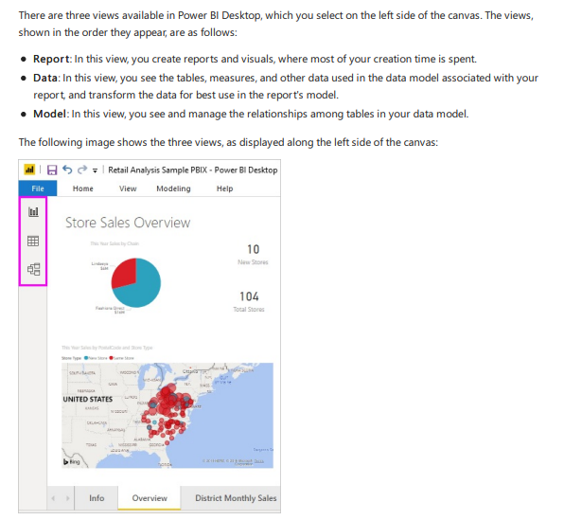

Slide 16
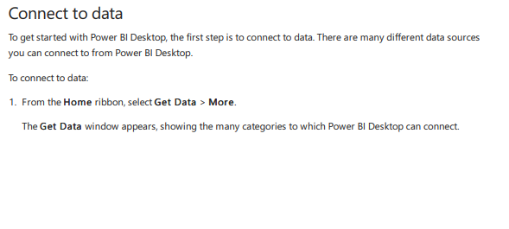

Slide 17
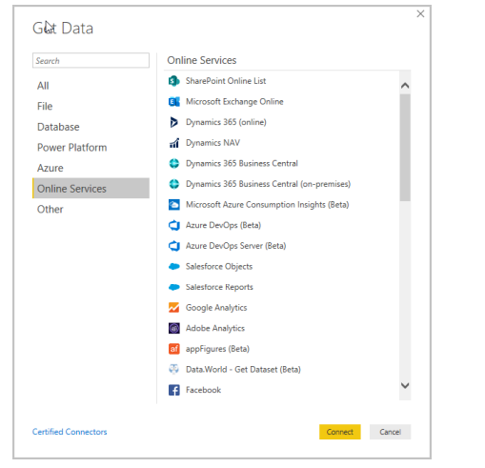

Slide 18
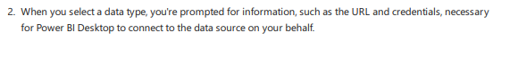
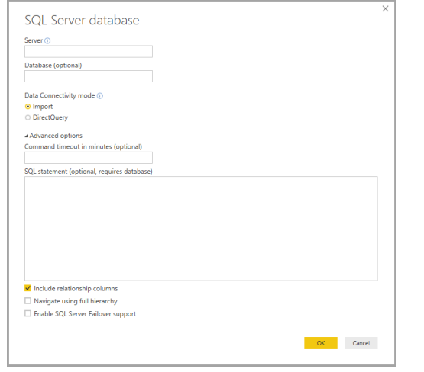

Slide 19
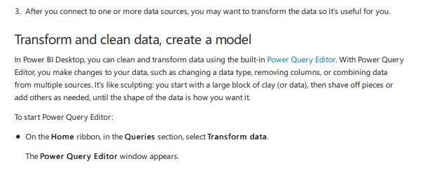

Slide 20
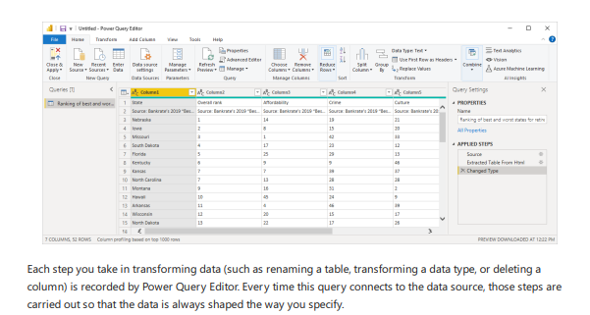

Slide 21
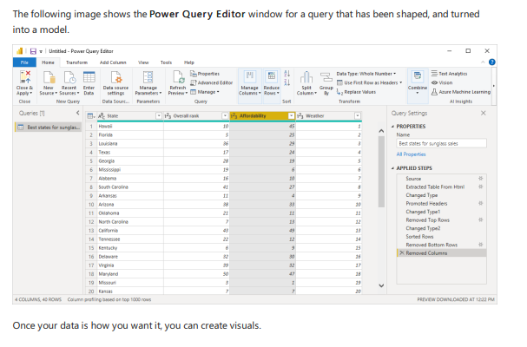

Slide 22
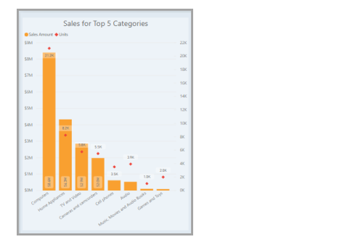
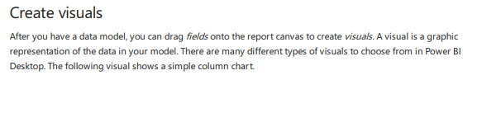

Slide 23
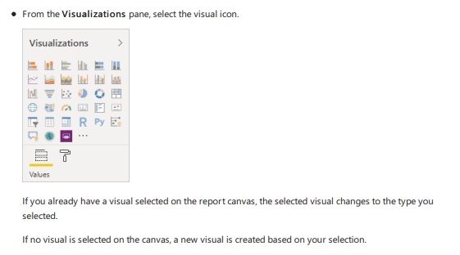

Slide 24
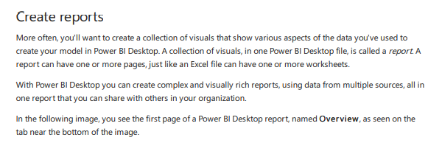

Slide 25
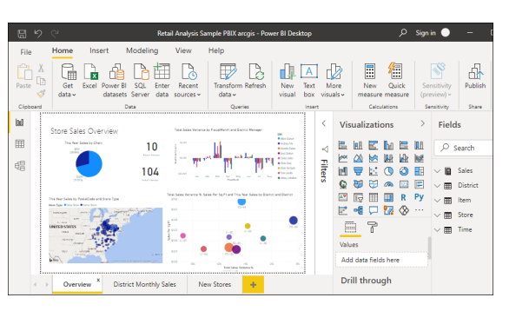

Slide 26
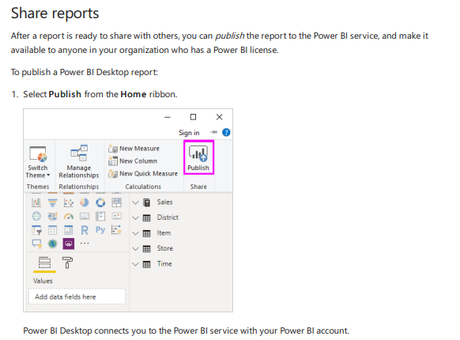

Slide 27
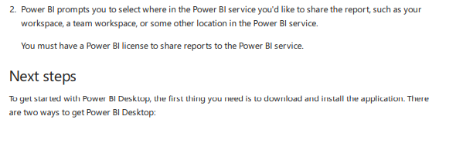
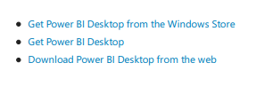

Slide 28
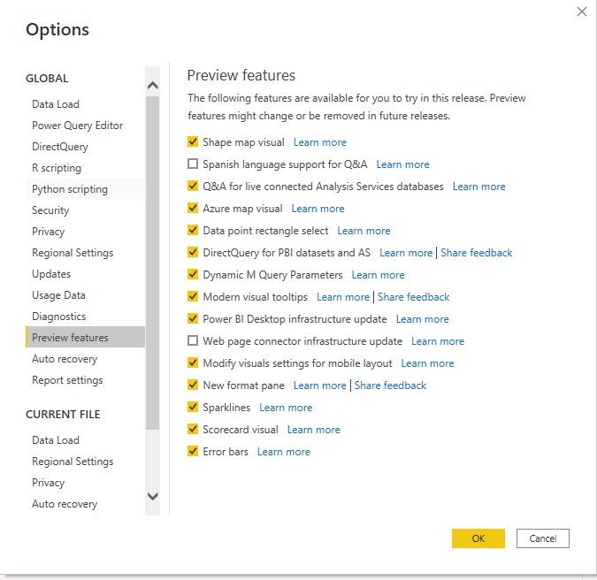
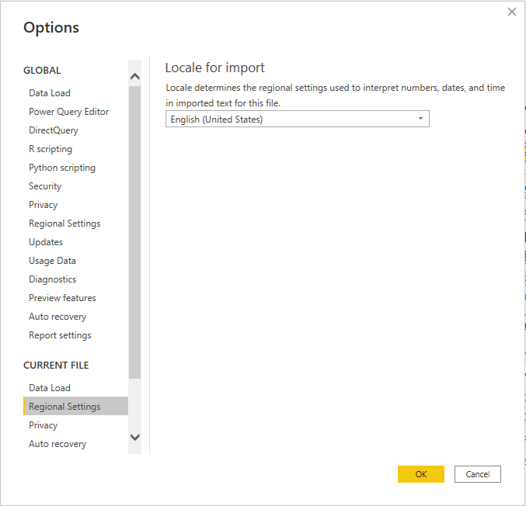
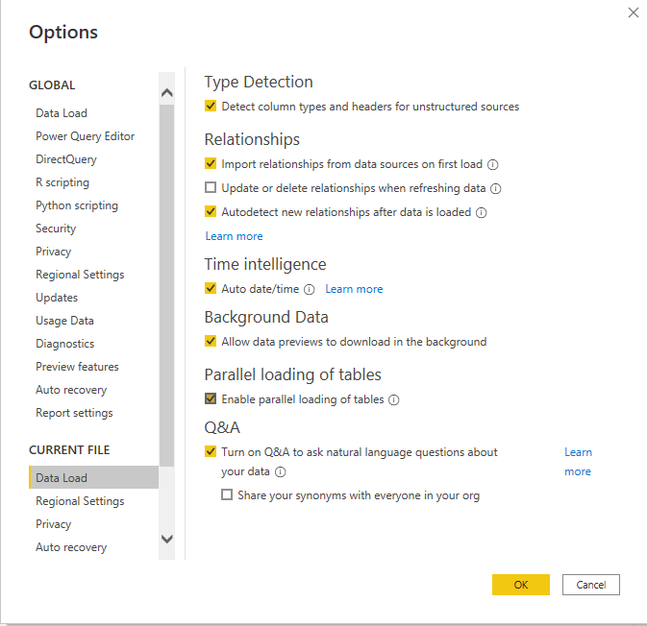

Slide 29
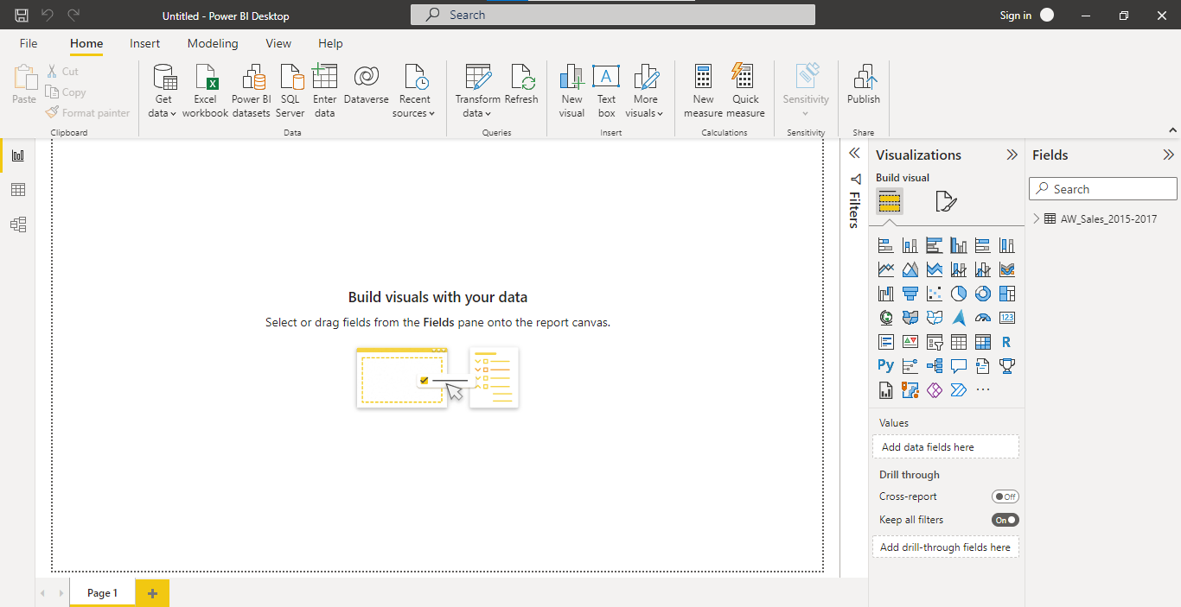
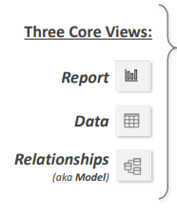

Slide 30
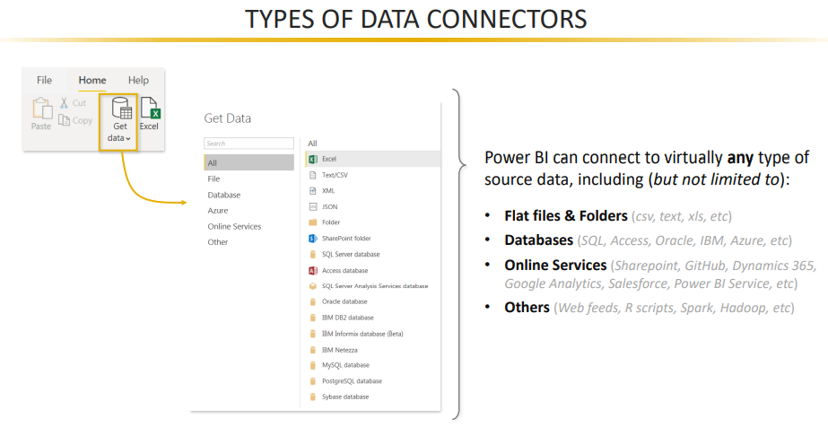

Slide 31
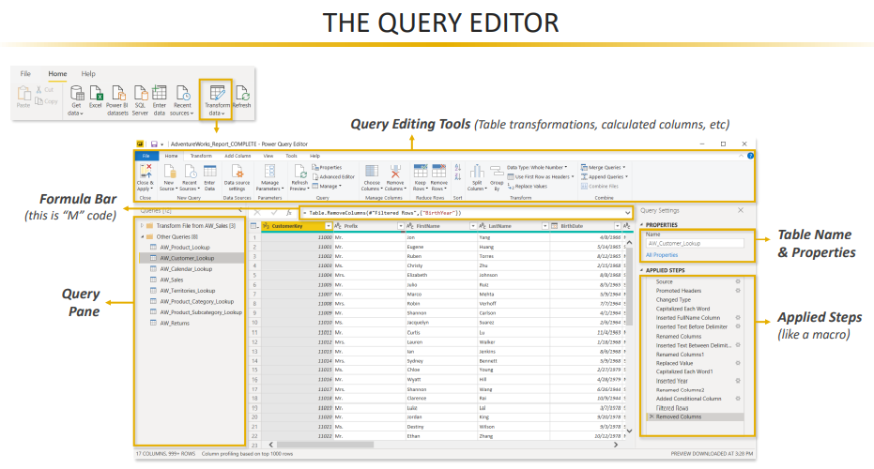

Slide 32
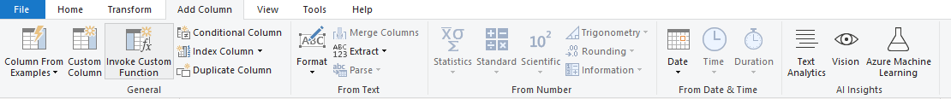

Slide 33
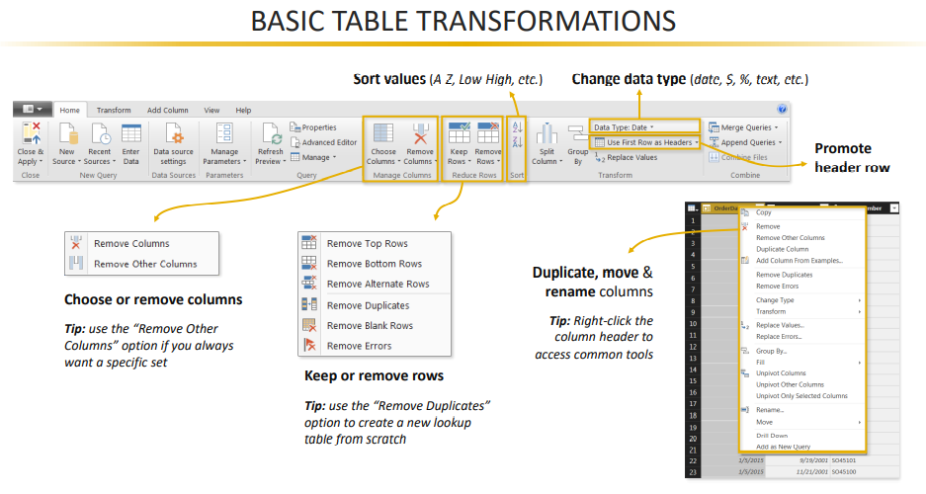

Slide 34
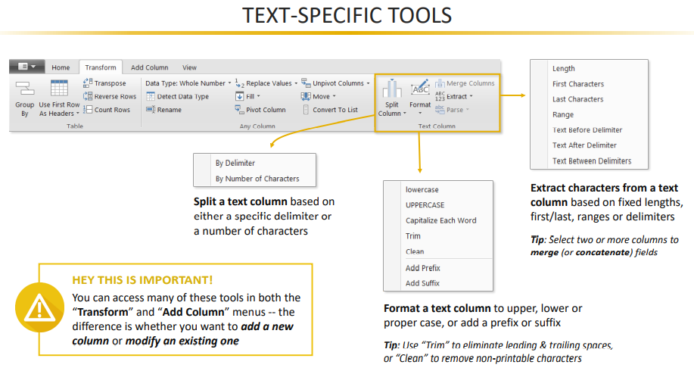

Slide 35
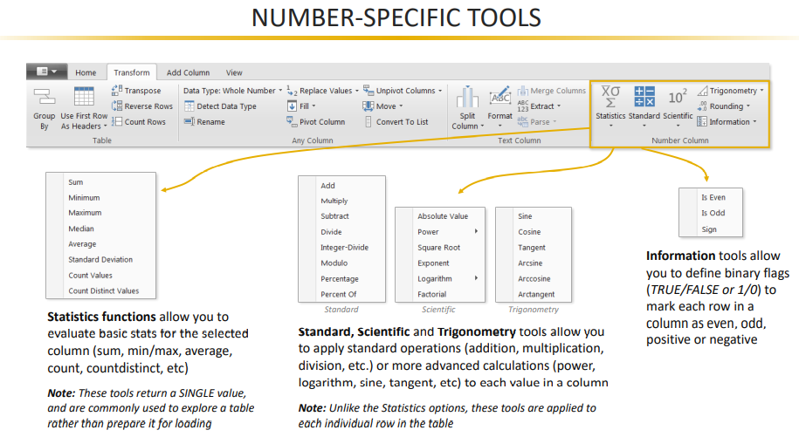

Slide 36
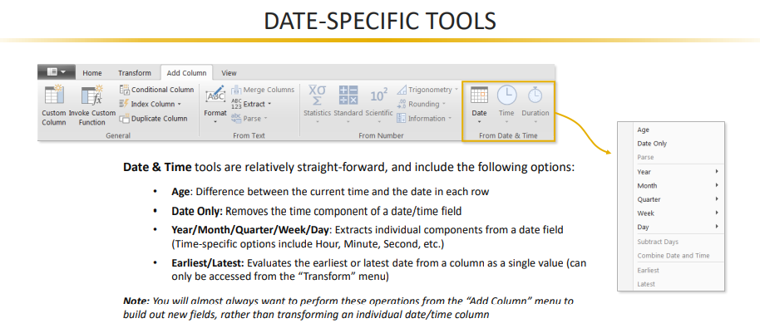

Slide 37
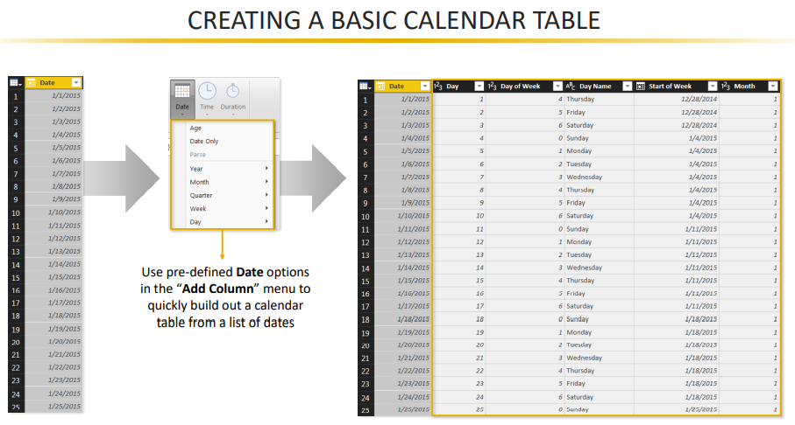

Slide 38
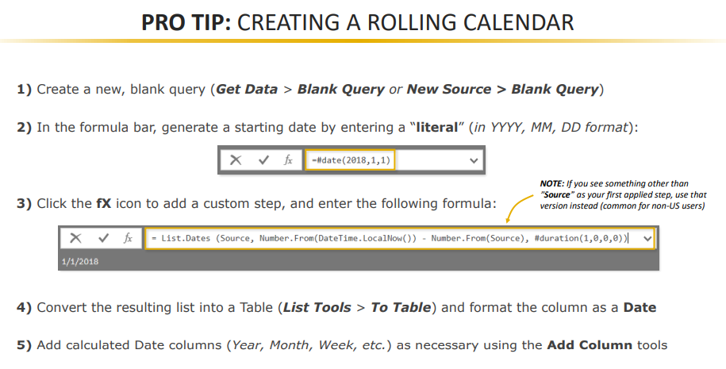
=#date(2022,1,1)
= List.Dates(Source, Number.From(DateTime.LocalNow())-Number.From(Source),#duration(1,0,0,0)

Slide 39
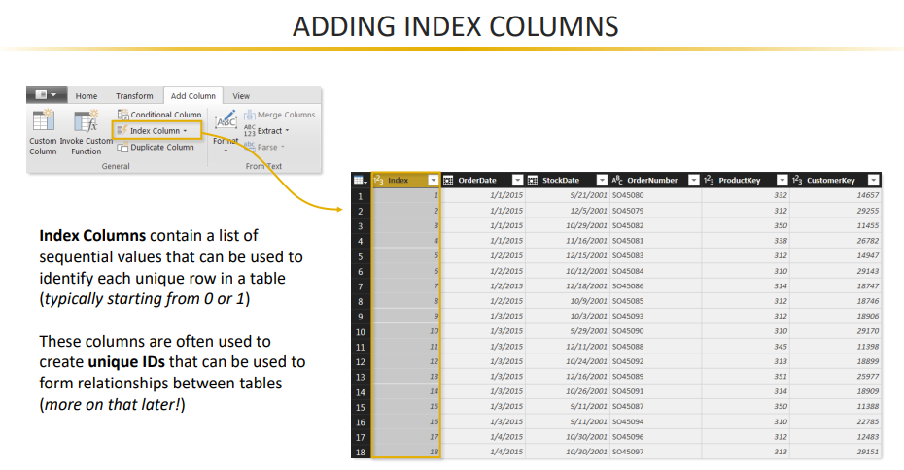

Slide 40
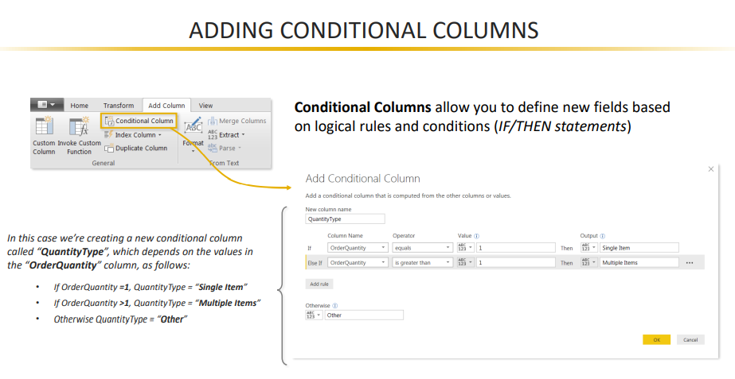

Slide 41
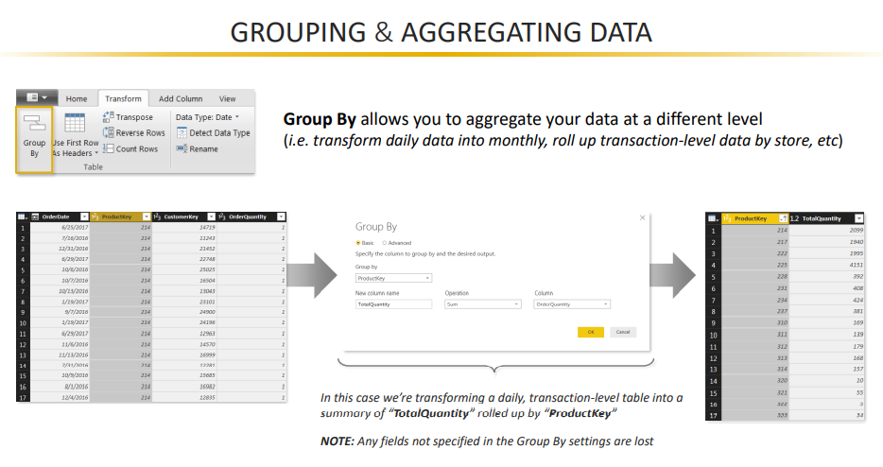

Slide 42
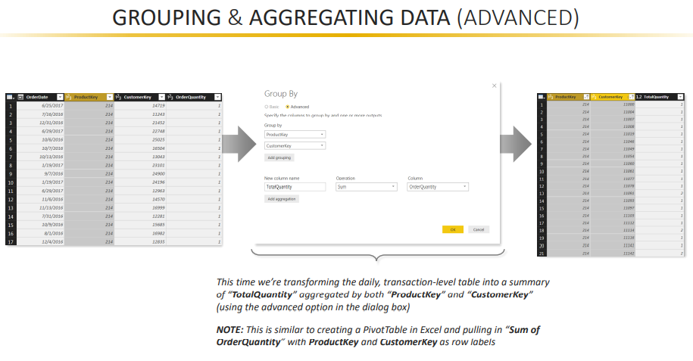

Slide 43
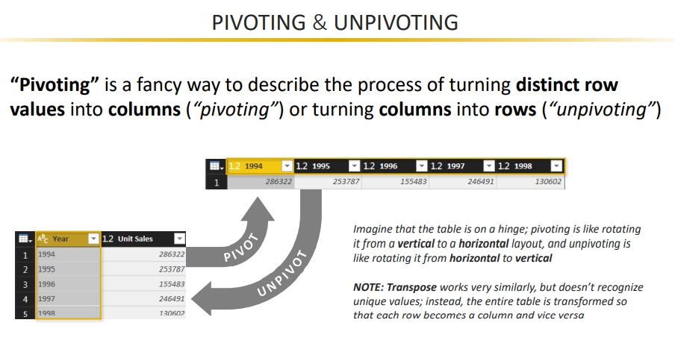

Slide 44
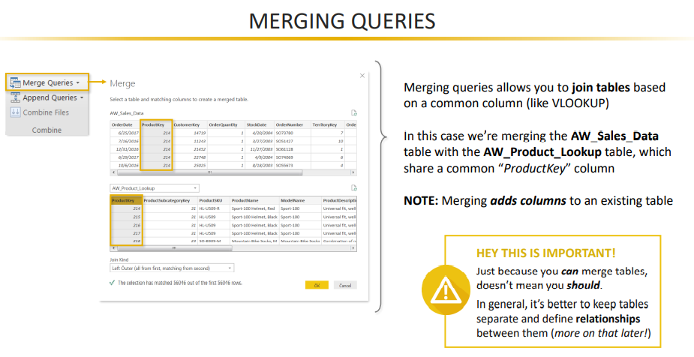

Slide 45


Slide 46


Slide 47


Slide 48


Slide 49


Slide 50


Slide 51



Slide 52


Slide 53


Slide 54


Slide 55


Slide 56


Slide 57


Slide 58


Slide 59


Slide 60


Slide 61


Slide 62


Slide 63


Slide 64


Slide 65


Slide 66


Slide 67


Slide 68


Slide 69


Slide 70


Slide 71


Slide 72


Slide 73


Slide 74


